Slide 1
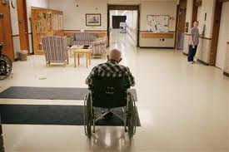
Infection Prevention and Control – Challenges for Long-term Care

Slide 2
Presented by:
Phenelle Segal, RN CIC
President, Infection Control Consulting Services, LLC
E-mail: info@iccs-home.com
Website: www.iccs-home.com
Tel #: 215-859-6954

Slide 3
OBJECTIVES
Describe the challenges of isolation precautions and how it affects resident movement within the long term care environment
List components of contact precautions for prevention of transmission of multi drug resistant organisms in long term care
Outline the importance of effective environmental cleaning for prevention of transmission of multi drug resistant organisms in long term care
Outline strategies for infection prevention across the continuum

Slide 4
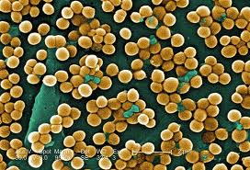
Top Challenge in LTC
Multi Drug Resistant Organisms (MDROs)

Slide 5
Multi Drug Resistant Organisms (MDROs)
“Bad Bugs”
MRSA - Methicillin-resistant Staphylococcus aureus
VRE - Vancomycin-resistant enterococci
ESBLs
CRE/CRKP

Slide 6
Consequences of
Resistant Organisms
Increased morbidity and mortality
Increased number of hospitalizations
Increased length of stay (LOS)
Change in the approach to the administration
of “empiric antimicrobial therapy”
Emergence of strains totally resistant to all
available antimicrobials

Slide 7
Economic Impact of Resistant Organisms
2 million HAIs annually
Approximately 20% due to resistant organisms
Estimated cost of MDRO HAIs - $4.5 billion
annually
19,000 deaths annually from resistant organisms
11th leading cause of death

Slide 8
Why have Resistant Organism
Rates Increased
Inappropriate use of antibiotics
Worldwide overuse of antibiotics
Extensive use in upper respiratory
and urinary tract colonization/infections
Lack of hand hygiene
Lack of compliance with Infection Control
measures

Slide 9
Antibiotic Resistance in LTC
Colonization common
Carriage probably prolonged
Carriage associated with debility
Carriage several resistant pathogens
Better infection definitions needed
Benchmarks/thresholds needed

Slide 10
Antibiotic Resistance in LTC
Develop effective infection control strategies
Target to patient/resident risk and needs
Role of healthcare workers?
Role of antibiotic use?
restriction antibiotic classes
better diagnostics/infection criteria
reduce empiricism
Determine when decolonization appropriate

Slide 11
Infection Prevention Strategies in LTC
Hand hygiene
Isolation precautions
Identification of cases
Environmental disinfection
Appropriate use of antibiotics

Slide 12
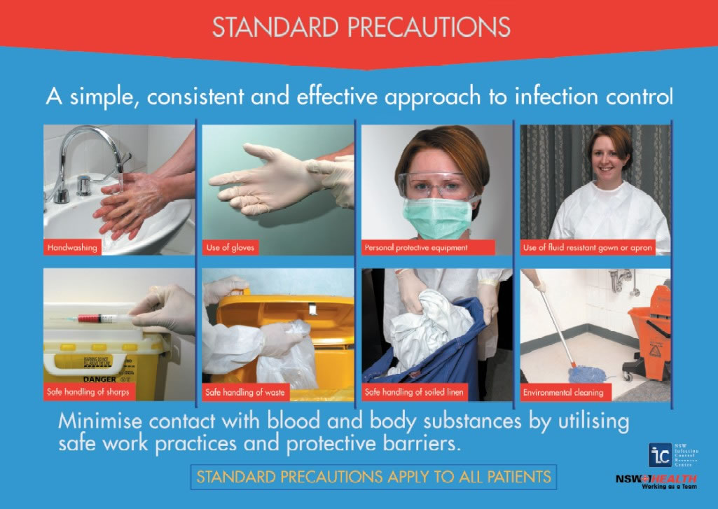
Standard Precautions

Slide 13
When to Use
Standard Precautions
For relatively healthy patients/residents (e.g., mainly independent) follow Standard Precautions, making sure that gloves and gowns are used for contact with uncontrolled secretions, pressure ulcers, draining wounds, stool incontinence, and ostomy tubes/bags

Slide 14
Rationale for facility-wide Standard Precautions
Reduction in transmission of infectious material from moist body substances
  Blood, feces, urine, saliva, sputum, wound exudates et al
  Gloves and gowns
Applied to all patients regardless of known status

Slide 15
Components of Standard Precautions
HAND HYGIENE to be practiced before and after care of every patient/resident regardless of the status of the person or the type of care
GLOVES to be worn each time care is rendered and the environment is encountered
GOWNS to be worn when anticipating contact with blood and body fluids/secretions/excreta
CLEAN EQUIPMENT between patient/resident use
ENVIRONMENTAL CLEANING to be undertaken at least daily and more often if indicated

Slide 16
Components of Standard Precautions
CLEAN GLUCOMETERS according to manufacturer’s instructions and between patients
SAFE INJECTION PRACTICES to be adhered to at all times to prevent cross contamination and transmission of infection to patients/residents and staff
RESPIRATORY HYGIENE: A respiratory hygiene/cough etiquette program is recommended whenever residents or visitors have symptoms of respiratory infection to prevent the transmission of all respiratory tract infections in long-term care facilities

Slide 17
Residents in LTCF cannot be “isolated” like patients in acute care facilities
Acute Care
Single room
Contact Precautions
  Gloves for walking into room
  Gowns for touching patient or environment
Restricted to room except for medically necessary activities
Long-term Care
Few single rooms; difficult to move patients
Residents are encouraged to interact with one another, eat in common areas and share other activities

Slide 18
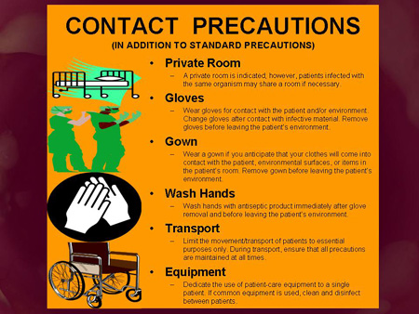
Contact Precautions/Isolation

Slide 19
When to use Contact Precautions
In LTCFs, consider the individual patient/resident’s clinical situation and prevalence or incidence of MDRO in the facility when deciding whether to implement or modify Contact Precautions in addition to Standard Precautions for a patient infected or colonized with a target MDRO
If secretions and drainage/stool is not contained, is uncontrolled and transmission of organisms is likely, consider stepping up to full or modified contact precautions in conjunction with Standard Precautions
While considering the use of contact precautions, also consider the resident’s rights for seclusion and isolation

Slide 20
Components of Contact Precautions/Isolation
USE OF A PRIVATE ROOM for patients/residents who have uncontrolled drainage/secretions/excretions or body fluids that may put other persons at risk for acquisition of an MDRO
LIMITING MOVEMENT AND TRANSPORT of the patient
DEDICATING the use of noncritical patient care equipment and items (such as stethoscopes, blood pressure cuffs, electronic thermometers to a single patient/resident or cohort of patients/residents infected or colonized with like-MDROs such as MRSA
ADEQUATELY cleaning and disinfecting items if use of common equipment or items is unavoidable, before use for another patient/resident using a facility approved cleanser/disinfectant

Slide 21
Patient or Resident placement
Single Rooms
When single-patient rooms are available, assign priority for these rooms to persons with known or suspected MDRO colonization or infection. Give highest priority to those persons who have conditions that may facilitate transmission, e.g., uncontained secretions or excretions

Slide 22
Patient or Resident placement
Cohorting “like” MDROs
When single-patient rooms are not available, cohort patients/residents with the same MDRO in the same room or patient-care area
What do you do with patients with multiple MDROs?

Slide 23
Patient or Resident placement
Cohorting “different” MDROs
When cohorting patients with the same MDRO is not possible, place MDRO patients in rooms with patients who are at low risk for acquisition of MDROs and associated adverse outcomes from infection and are likely to have short lengths of stay
Is this safe?

Slide 24
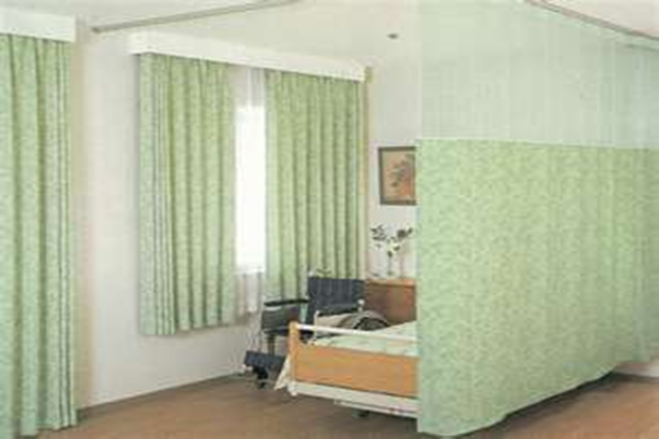
A tiered approach to Contact Precautions - Basic
Contact Precautions - gloves and gowns to enter room or cubicle
Do not re-use gowns
Supplies outside the room
In semi-private room, keep
cubicle curtain drawn to limit
movement between cubicles
and as a reminder of precautions

Slide 25
A tiered approach to Contact Precautions - Basic
Use dedicated equipment; if not feasible – decontaminate prior to use on another patient/resident
Maintain adequate supplies for contact precautions
Do not isolate asymptomatic carriers

Slide 26
A tiered approach to Contact Precautions - Enhanced
May consider alternative signage to ensure staff awareness (ramp up awareness without infringing on resident rights)
Evaluate current system for patient/resident placement
Increase monitoring of isolation precautions and hand hygiene
In CDI cases, consider contact precautions for all patients/residents that develop diarrhea until CDI is ruled out
In CDI cases, extend use of contact precautions even when diarrhea stops

Slide 27
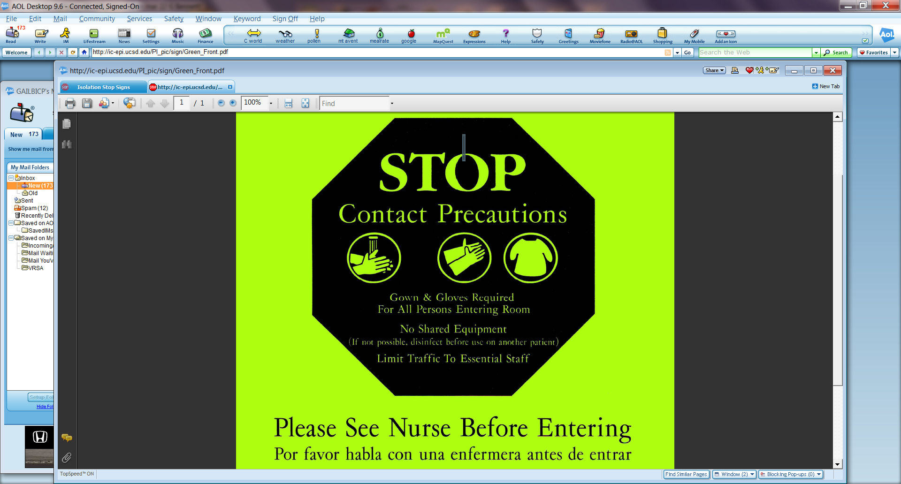
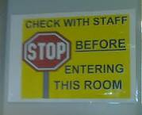
Signage for Transmission based Precautions

Slide 28
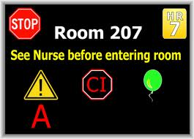
Signage for Transmission based Precautions

Slide 29
MDRO Guidelines, December 2006
V.A.5.f. Discontinuation of Contact Precautions
No recommendation can be made regarding when to discontinue Contact Precautions Unresolved issue
But what do we do?

Slide 30
MDRO Guidelines, December 2006
V.A.5.f. Discontinuation of Contact Precautions.
No recommendation can be made regarding when to discontinue Contact Precautions. Unresolved issue
But what do we do?

Slide 31
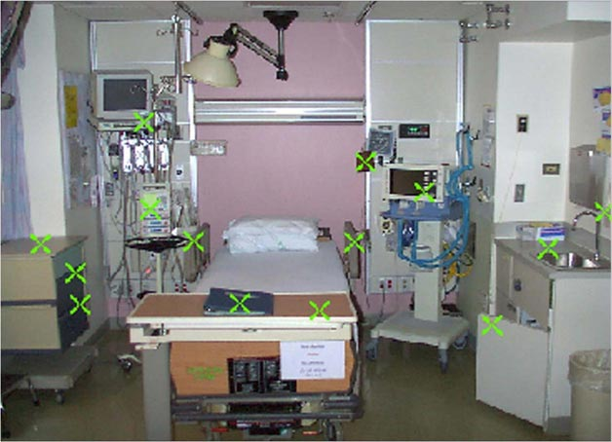
The Inanimate Environment Can Facilitate Transmission
X represents VRE culture positive sites
~ Contaminated surfaces increase cross-transmission ~
Abstract: The Risk of Hand and Glove Contamination after Contact with a VRE (+) Patient Environment. Hayden M, ICAAC, 2001, Chicago, IL.
Notes:
31
31
Isolation, Resistant Organisms, Hand Hygiene - Ethica
31
In one study, hands of 131 healthcare workers (HCWs) were cultured before, and hands and gloves after, routine care.
A mean of 56% of body sites and 17% of environmental sites were VRE positive.
After touching the patient and environment, 75% of ungloved HCWs hands and 9% of gloved HCWs hands were contaminated with VRE.
After touching only the environment, 21% of ungloved and 0 gloved HCWs hands were contaminated.
The inanimate environment plays a role in facilitating transmission of organisms.

Slide 32
MDRO Guidelines, December 2006
V.A.6. Environmental measures
V.A.6.a. Clean and disinfect surfaces and equipment that may be contaminated with pathogens, including those that are in close proximity to the patient (e.g., bed rails, over bed tables) and frequently-touched surfaces in the patient care environment (e.g., door knobs, surfaces in and surrounding toilets in patients’ rooms) on a more frequent schedule compared to that for minimal touch surfaces (e.g., horizontal surfaces in waiting rooms)
V.A.6.b. Dedicate noncritical medical items to use on individual patients known to be infected or colonized with MDROs
V.A.6.c. Prioritize room cleaning of patients on Contact Precautions. Focus on cleaning and disinfecting frequently touched surfaces (e.g., bedrails, bedside commodes, bathroom fixtures in the patient’s room, doorknobs) and equipment in the immediate vicinity of the patient

Slide 33
Let’s discuss………….
Handling of commodes in a semi- private room of a patient/resident with CDI
Cleaning of keyboards/keypads
Cleaning of Glucometers

Slide 34
OBJECTIVES
Describe the challenges of isolation precautions and how it affects resident movement within the long term care environment
List components of contact precautions for prevention of transmission of multi drug resistant organisms in long term care
Outline the importance of effective environmental cleaning for prevention of transmission of multi drug resistant organisms in long term care
Outline strategies for infection prevention across the continuum

Slide 35
References
Management of Multidrug-Resistant Organisms In
Healthcare Settings 2006 http://www.cdc.gov/hicpac/pdf/guidelines/MDROGuideline2006.pdf
2007 Guideline for Isolation Precautions: Preventing Transmission of Infectious Agents in Healthcare Settings http://www.cdc.gov/hicpac/pdf/isolation/Isolation2007.pdf
APIC Guide to the Elimination of Clostridium difficile Infections in Healthcare Settings. http://www.apic.org/Content/NavigationMenu/PracticeGuidance/APICEliminationGuides/C.diff_Elimination_guide_logo.pdf

Slide 36

Q & A

